Slide 1




DATA 200 Review
Liam Riener, Kim Jun Sik, Olivia Petronio, Amanda Altamirano

Slide 2
Topic 1: Introduction to Database Systems, Jupyter Notebooks, GitHub
Topic 2: File systems and paths
Topic 3: Introduction to Numpy
Topic 4: Introduction to Pandas
Topic 5: Visualization with Matplotlib
Topic 6: Tabular Model
Topic 7: Relational Models
Topic 8: Coding with Relational Models: SQL
Topic 9: Hierarchical Model
Topic 10: Introduction to APIs and Web-scraping

Slide 3
TOPIC 1: INTRO OPEN JUPYTER NOTEBOOK Start a new notebook

Slide 4
Topic 2: File Paths
OS utilize hierarchical organization to organize files
The root and interior nodes of the tree act as a directory
Paths transverse resource trees starting at the source and ending at the destination node
File paths are strings that represent the location of a file
Folder path (location in file system)
File name
Extension
Read in this file- use pd.read_csv("filename")
Notes:
Read in file

Slide 5

Topic 3: NumPy
NumPy arrays- endless dimensions, must be same data type
Numerical analysis, computing
Start w/ a normal array: [1,2,3,4,5]
np.array() – Creates a NumPy array
np.arange() – evenly spaced values
np.linspace() – evenly spaced btwn range
np.reshape() – Reshape w/o data change
np.mean(), np.sum(), np.median()
np.percentile(), np.var(), np.std()
Min, max, argmin, argmax (index pos)

Slide 6
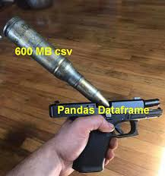
Topic 4: Pandas
Pandas dataframe- 2 dimensions, any data type, a bit slower
data analysis, cleaning, merging, reshaping
pd.DataFrame() – pandas dataframe
df.head(), df.tail()- first and last 5 rows
df.info(), df.summary()- overview, stats
df.loc(), df.iloc()- locating by value, position
df.drop()- drops by value, position, axis
df.groupby()- aggregating data
df.merge()- merge on common column
df.fillna()- fills missing data

Slide 7
Topic 5: Matplotlib
Data visualization and plotting
plt.plot(), scatter(), bar()- line, scatter, bar
X and y axis in argument, maybe label
plt.hist(data, bins = #bins)- histogram
plt.title(), xlabel(), ylabel()
plt.legend()- add legend to plot
plt.figure(figsize=(width, height)) for size
plt.grid()- grid lines for readability
plt.savefig()- downloads plot as image
plt.show() at end to display

Slide 8

Topic 6: Tabular Model
Structured in rows and columns
Tabular operations allow us to access subsets of data, to merge multiple tables together, and to mutate tables to meet logical constraints
Constraints can ensure that there are no repeated rows and that columns represent individual variables
The most common format for tabular data is csv
Notes:
Each row contains the same number of cells (although some of these cells may be empty), which provide values of the properties of the thing described by the row
in tabular data, cells within the same column provide values for the same property of the things described by each row. This is what differentiates tabular data from other line-oriented formats.
organizes data into rows and columns, making it easy to analyze using statistical methods, visualization, and machine learning techniques. Pandas DataFrames are a great example of this in Python
Easy to load and manipulate in Pandas
Works well for small, self-contained datasets
Less efficient when there’s duplicate data

Slide 9
Topic 6: Tabular Model Example
import pandas as pd
file_path = '/Users/amandaaltamirano/Downloads/UberDataset 2.csv'
data = pd.read_csv(file_path)
print(data.info())
data.head()
#check for missing values
data.isnull().sum()
#options for missing data
cleaned_data = data.dropna()
cleaned_data.head()
#or
data_filled = data.fillna("Unknown")
data_filled.head()
#summerize data ​
data.describe()​
​
#unique categories ​
data['CATEGORY'].value_counts()
Notes:
First, let's load the dataset and take a look at its structure using Pandas and confirm that the dataset is structured in a tabular format
Next, we check for missing values, missing data can affect our analysis, so we need to handle it properly
options for handling missing data:
Remove rows with missing values or fill missing values w a placeholder
We can now generate summary statistics to understand the dataset better
We can filter the dataset based on conditions. Let’s find trips longer than 10 miles
long_trips = data[data['MILES'] > 10]
long_trips.head()

Slide 10

Topic 7: Relational Models
Provides data in the form of relational tables in response to queries.
Stores data in multiple related tables instead of one large table. These tables are connected using keys:
Primary Key (PK): A unique identifier for each row (e.g., TRIP_ID for trips).
Foreign Key (FK): A reference to a primary key in another table (e.g., CATEGORY_ID in the Trips table, linking to Categories).
Notes:
Example systems include servers running Oracle, MySQL, and PostgreSQL.
Consists of database tables with additional structure, facilitating the use of database queries
The structure facilitates relationships between tables, so that an organization can represent complex data using multiple tables, one for each type of data the organization wishes to keep.
the constraints ensure sound database design, that all entries in a column have the same type, and that tables are appropriately linked to facilitate queries involving data spread across multiple tables (for example, data on both students and courses they are registered for).
The most used and important function in relational models is JOIN, which combines data from different tables.
While a tabular model is good for single tables, relational databases allow us to link multiple tables together
structures data into multiple tables with defined relationships, reducing redundancy and improving efficiency. Instead of storing everything in one table, we normalize the data into separate tables that are linked by primary keys (PK) and foreign keys (FK).
Removes redundancy (no repeated category names)
Allows relationships between data (trips linked to categories)
Enables powerful SQL queries for complex analysis

Slide 11
Topic 7: Relational Models Example
import sqlite3
import pandas as pd
conn = sqlite3.connect(":memory:")
cursor = conn.cursor()
#create two related tables
cursor.execute("CREATE TABLE Categories (CATEGORY_ID INTEGER PRIMARY KEY, CATEGORY TEXT)")
cursor.execute("CREATE TABLE Trips (TRIP_ID INTEGER PRIMARY KEY, START_DATE TEXT, MILES REAL, CATEGORY_ID INTEGER, FOREIGN KEY (CATEGORY_ID) REFERENCES Categories(CATEGORY_ID))")
Notes:
While a tabular model is good for single tables, relational databases allow us to link multiple tables together
structures data into multiple tables with defined relationships, reducing redundancy and improving efficiency. Instead of storing everything in one table, we normalize the data into separate tables that are linked by primary keys (PK) and foreign keys (FK).
Removes redundancy (no repeated category names)
Allows relationships between data (trips linked to categories)
Enables powerful SQL queries for complex analysis
#connect to SQLite (creates a database in memory for speed)
#create two related tables: Trips, Categories
Now, I’ll show a quick demo of how a relational model works using SQLite in Python. Instead of storing all data in one big table, we will split it into multiple related tables and use SQL to join them
First, we import SQLite and Pandas. SQLite is a lightweight database that lets us store relational data, and Pandas will help us display query results in a clean format
We create an in-memory SQLite database, meaning it runs temporarily in RAM for quick testing
Now, we create our first table, Categories. This table has two columns: CATEGORY_ID, which is a unique primary key, and CATEGORY, which stores the name of the category
Next, we create the Trips table, which stores trip data like the start date and miles traveled. It also has a CATEGORY_ID, which links each trip to a category in the Categories table using a foreign key

Slide 12
Topic 7: Relational Models Example
#insert data
cursor.executemany("INSERT INTO Categories (CATEGORY) VALUES (?)", [("Business",), ("Personal",)])
cursor.executemany("INSERT INTO Trips (START_DATE, MILES, CATEGORY_ID) VALUES (?, ?, ?)", [
("2024-01-01", 10.2, 1),
("2024-01-02", 5.4, 2)
])
conn.commit()
#run a join query
query = '''
SELECT Trips.TRIP_ID, Trips.START_DATE, Trips.MILES, Categories.CATEGORY
FROM Trips
JOIN Categories ON Trips.CATEGORY_ID = Categories.CATEGORY_ID;
'''
pd.read_sql_query(query, conn)
Notes:
While a tabular model is good for single tables, relational databases allow us to link multiple tables together
structures data into multiple tables with defined relationships, reducing redundancy and improving efficiency. Instead of storing everything in one table, we normalize the data into separate tables that are linked by primary keys (PK) and foreign keys (FK).
Removes redundancy (no repeated category names)
Allows relationships between data (trips linked to categories)
Enables powerful SQL queries for complex analysis
Now, we insert two categories: Business and Personal. Each one gets a unique ID
Next, we insert two trips. Each trip is linked to a category using the CATEGORY_ID column
Now, we run a SQL query that joins the Trips and Categories tables, so we can see each trip with its category name instead of just an ID
Finally, we use Pandas to display the results in a readable table

Slide 13

Topic 8: SQL

Slide 14
Topic 8: SQL
Query | Execution Order | Why
SELECT | FROM | Has to know which table to query from
FROM | WHERE | SQL filtering the rows
WHERE | GROUP BY | SQL checks for any aggregation in query
GROUP BY | SELECT | After all calculations, SQL selects which columns to show
ORDER BY | ORDER BY | Sorts the data returned
LIMIT | LIMIT | SQL limits the # of rows returned

Slide 15
Topic 8: SQL
pip install ipython.sql
%load_ext sql
%sql sqlite:////Users/junsik/Desktop/book.db
%%sql
SELECT name
FROM sqlite_master
WHERE type = 'table'

Slide 16

Topic 8: SQL
SELECT *
FROM countries
WHERE land > 20000
SELECT *
FROM indicators
WHERE code IN ('USA')
SELECT *
FROM indicators
WHERE code LIKE 'A%'

Slide 17
Topic 8: SQL
SELECT *
FROM countries
WHERE land IS NOT NULL
LIMIT 10;
SELECT *
FROM countries
WHERE code LIKE "__A" AND income IS 'High Income';
SELECT *, life > 70 AS long_life
FROM indicators0
ORDER BY gdp;

Slide 18
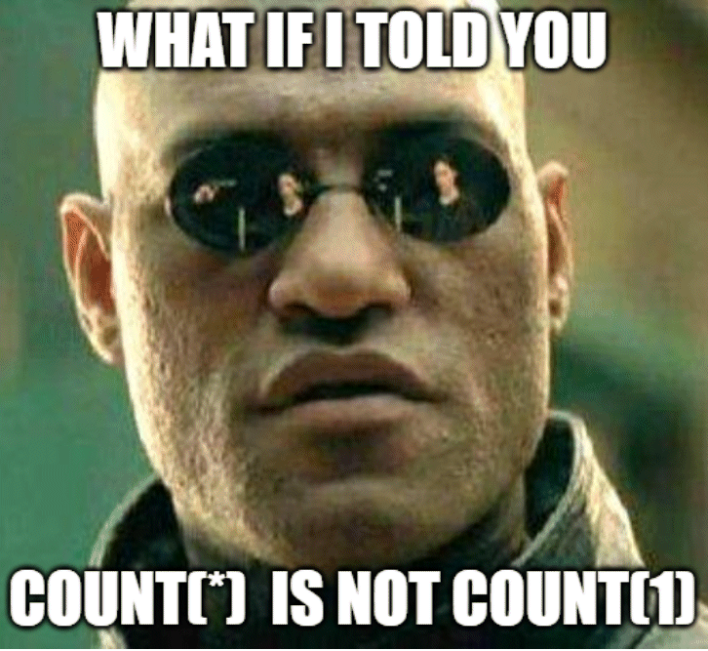
Topic 8: SQL
SELECT COUNT(*) AS total, (SELECT COUNT(*) FROM countries WHERE land IS NULL) AS missing
FROM countries;
SELECT COUNT(DISTINCT name) AS unique_names
FROM topnames;

Slide 19

Topic 8: SQL
SELECT instructorid, instructorfirst, instructorlast, departmentid, division
FROM instructors
INNER JOIN instructor_class USING(instructorid)
INNER JOIN departments USING(departmentid)
WHERE classid IN (21014,21088,21256,21444);
SELECT *
FROM indicators
LEFT JOIN countries USING(code)
WHERE indicators.code IS NOT NULL
LIMIT 5;

Slide 20
Topic 9: Hierarchical Models
Database management system
Organizes information in a tree like structure
Many to one structure allows for easy and efficient access of data

Slide 21
Topic 10: Web Scraping and APIs
Web Scraping
Technique for gathering data on web pages
Data is often static (already consisting of a textual HTML file)
Not rate limited
Access and gather anonymously
APIs
Enables two software components to communicate
Data is often dynamic, generated based on request
Rate limited
Probably will need an API key
Notes:
Need to extract a lot of data that cannot be done through an API due to rate limiting

Slide 22
Topic 10: Web Scraping
We will be scraping this website!
find_element(s)() –
Locate a specific web element on a webpage
Returns web element
Specify a locating strategy (xpath, id, class)
element = driver.find_element(‘xpath’, ‘//actual xpath’)
get_attribute() –
Retrieve the value of an attribute from a located element
Returns a string
element.get_attribute(’title’)

Slide 23
Unit 10: APIs
Create functions to get necessary information
Use requests.get()
To get information
Response.json()
Put in json format
Print the data
Extract data from for loop

Slide 24
Thanks for watching

